Slide 1
Evolutionary Computing
Chapter 9
Working with Evolutionary Algorithms

Slide 2
Working with Evolutionary Algorithms
Experiment design
Algorithm design
Test problems
Measurements and statistics
Some tips and summary

Slide 3
Experimentation
Has a goal or goals
Involves algorithm design and implementation
Needs problem(s) to run the algorithm(s) on
Amounts to running the algorithm(s) on the problem(s)
Delivers measurement data, the results
Is concluded with evaluating the results in the light of the given goal(s)
Is often documented

Slide 4
Experimentation: Goals
Get a good solution for a given problem
Show that EC is applicable in a (new) problem domain
Show that my_EA is better than benchmark_EA
Show that EAs outperform traditional algorithms (sic!)
Find best setup for parameters of a given algorithm
Understand algorithm behavior (e.g. pop dynamics)
See how an EA scales-up with problem size
See how performance is influenced by parameters
…

Slide 5
Example: Production Perspective
Repetitive problems: similar instances with some variations in details
For instance, optimising internet shopping delivery route
Different destinations each day
Limited time to run algorithm each day
Must always be reasonably good route in limited time

Slide 6

Example: Design Perspective
One-off problems: “unique” requirements and conditions
For instance, improvements to national road network
Total cost: billions of €
Computing costs negligible
Six months to run algorithm on hundreds computers is okay
Many runs possible
Must produce very good result just once

Slide 7
Perspectives of goals
Design perspective:
find a very good solution at least once
Production perspective:
find a good solution in almost every run
Publication perspective:
must meet scientific standards (huh?)
Application perspective:
good enough is good enough (verification!)
These perspectives have very different implications on evaluating the results (yet often left implicit)

Slide 8
Algorithm design
Design a representation (i.e., a genotype space)
Design a way of mapping a genotype to a phenotype
Design a way of evaluating an individual
Design suitable mutation operator(s)
Design suitable recombination operator(s)
Decide how to select individuals to be parents
Decide how to select individuals for the next generation (how to manage the population)
Decide how to start: initialization method
Decide how to stop: termination criterion

Slide 9
Test problems
Classic: 5 DeJong functions
Modern: 25 “hard” objective functions
Frequently encountered or otherwise important variants of given practical problem
Selection from recognized benchmark problem repository (“challenging” by being NP--- ?!)
Problem instances made by random generator
Choice has severe implications on
generalizability and
scope of the results

Slide 10
Bad example (1/2)
I invented “tricky mutation”
Showed that it is a good idea by:
Running standard (?) GA and tricky GA
On 10 objective functions from the literature
Finding tricky GA better on 7, equal on 1, worse on 2 cases
I wrote it down in a paper
And it got published!
Q: what did I learned from this experience?
Q: is this good work?

Slide 11
Bad example (2/2)
What did I (my readers) did not learn:
How relevant are these results (test functions)?
What is the scope of claims about the superiority of the tricky GA?
Is there a property distinguishing the 7 good and the 2 bad functions?
Are my results generalizable? (Is the tricky GA applicable for other problems? Which ones?)

Slide 12
Getting Problem Instances (1/3)
Testing on real data
Advantages:
Results could be considered as very relevant viewed from the application domain (data supplier)
Disadvantages
Can be over-complicated
Can be few available sets of real data
May be commercially sensitive – difficult to publish and to allow others to compare
Results are hard to generalize

Slide 13
Getting Problem Instances (2/3)
Standard data sets in problem repositories, e.g.:
OR-Library http://www.ms.ic.ac.uk/info.html
UCI Machine Learning Repository www.ics.uci.edu/~mlearn/MLRepository.html
Advantage:
Well-chosen problems and instances (hopefully)
Much other work on these → results comparable
Disadvantage:
Not real – might miss crucial aspect
Algorithms get tuned for popular test suites

Slide 14
Getting Problem Instances (3/3)
Problem instance generators produce simulated data for given parameters, e.g.:
GA/EA Repository of Test Problem Generators http://www.cs.uwyo.edu/~wspears/generators.html
Advantage:
Allow very systematic comparisons for they
can produce many instances with the same characteristics
enable gradual traversal of a range of characteristics (hardness)
Can be shared allowing comparisons with other researchers
Disadvantage
Not real – might miss crucial aspect
Given generator might have hidden bias

Slide 15
Basic rules of experimentation
EAs are stochastic →
never draw any conclusion from a single run
perform sufficient number of independent runs
use statistical measures (averages, standard deviations)
use statistical tests to assess reliability of conclusions
EA experimentation is about comparison →
always do a fair competition
use the same amount of resources for the competitors
try different comp. limits (to cope with turtle/hare effect)
use the same performance measures

Slide 16
Things to Measure
Many different ways. Examples:
Average result in given time
Average time for given result
Proportion of runs within % of target
Best result over n runs
Amount of computing required to reach target in given time with % confidence
…

Slide 17
What time units do we use?
Elapsed time?
Depends on computer, network, etc…
CPU Time?
Depends on skill of programmer, implementation, etc…
Number of generations?
Difficult to compare when parameters like population size change
Number of evaluations?
Evaluation time could depend on algorithm, e.g. direct vs. indirect representation

Slide 18
Measures
Performance measures (off-line)
Efficiency (alg. speed)
CPU time
No. of steps, i.e., generated points in the search space
Effectivity (alg. quality)
Success rate
Solution quality at termination
“Working” measures (on-line)
Population distribution (genotypic)
Fitness distribution (phenotypic)
Improvements per time unit or per genetic operator
…

Slide 19
Performance measures
No. of generated points in the search space
= no. of fitness evaluations (do not use no. of generations!)
AES: average number of evaluations to solution
SR: success rate = % of runs finding a solution (individual with acceptable quality / fitness)
MBF: mean best fitness at termination, i.e., take the best per run and take the mean of these over a set of runs
SR ≠ MBF
Low SR, high MBF: good approximizer (more time helps?)
High SR, low MBF: “Murphy” algorithm

Slide 20
Performance measures
given, ? measured
?
Solution quality
?
Algorithm speed
Question: how does Success Rate fit in?

Slide 21
Fair experiments
Basic rule: use the same computational limit for each competitor
Allow each EA the same no. of evaluations, but
Beware of hidden labour, e.g. in heuristic mutation operators
Beware of possibly fewer evaluations by smart operators
EA vs. heuristic: allow the same no. of steps:
Defining “step” is crucial, might imply bias!
Scale-up comparisons eliminate this bias

Slide 22
Example: off-line performance measure evaluation
Which algorithm is better? Why? When?

Slide 23
Example: on-line performance measure evaluation
Populations mean (best) fitness
Algorithm A
Algorithm B
Which algorithm is better? Why? When?

Slide 24
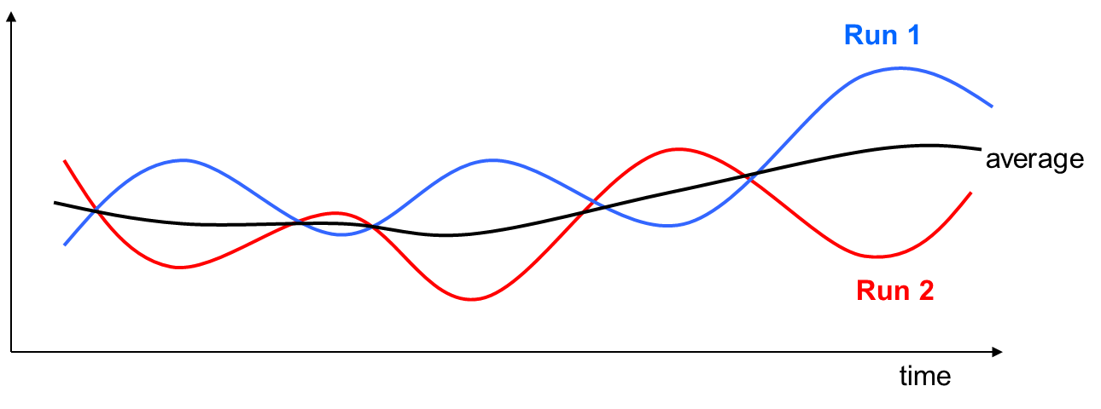
Example: averaging on-line measures
Averaging can “choke” interesting information

Slide 25
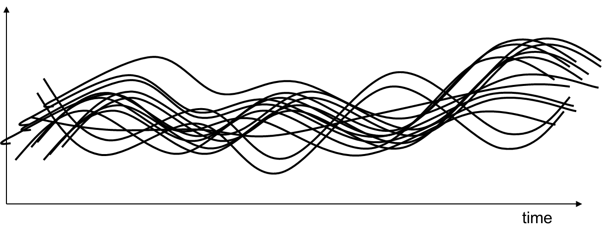
Example: overlaying on-line measures
Overlay of curves can lead to very “cloudy” figures

Slide 26
Statistical Comparisons and Significance
Algorithms are stochastic, results have element of “luck”
If a claim is made “Mutation A is better than mutation B”, need to show statistical significance of comparisons
Fundamental problem: two series of samples (random drawings) from the SAME distribution may have DIFFERENT averages and standard deviations
Tests can show if the differences are significant or not

Slide 27
Example
Is the new method better?

Slide 28
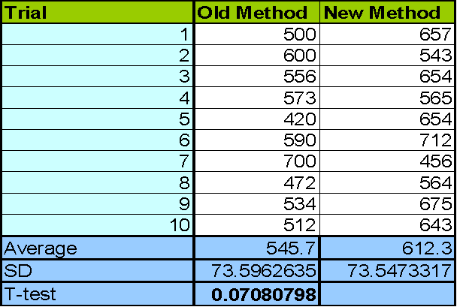
Example (cont’d)
Standard deviations supply additional info
T-test (and alike) indicate the chance that the values came from the same underlying distribution (difference is due to random effects) E.g. with 7% chance in this example.

Slide 29
Statistical tests
T-test assummes:
Data taken from continuous interval or close approximation
Normal distribution
Similar variances for too few data points
Similar sized groups of data points
Other tests:
Wilcoxon – preferred to t-test where numbers are small or distribution is not known.
F-test – tests if two samples have different variances.

Slide 30
Statistical Resources
There are lists of free and open source statistical software on the Internet
Some ideas:
https://www.r-project.org/
http://www.octave.org/
Microsoft Excel

Slide 31
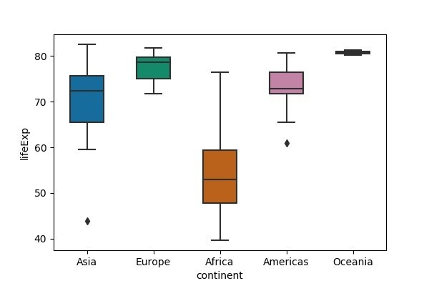
Boxplots
https://towardsdatascience.com/understanding-boxplots-5e2df7bcbd51
https://cmdlinetips.com/2018/03/how-to-make-boxplots-in-python-with-pandas-and-seaborn/

Slide 32
Better example: problem setting
I invented myEA for problem X
Looked and found 3 other EAs and a traditional benchmark heuristic for problem X in the literature
Asked myself when and why is myEA better

Slide 33
Better example: experiments
Found/made problem instance generator for problem X with 2 parameters:
n (problem size)
k (some problem specific indicator)
Selected 5 values for k and 5 values for n
Generated 100 problem instances for all combinations
Executed all alg’s on each instance 100 times (benchmark was also stochastic)
Recorded AES, SR, MBF values w/ same comp. limit
(AES for benchmark?)
Put my program code and the instances on the Web

Slide 34
Better example: evaluation
Arranged results “in 3D” (n,k) + performance (with special attention to the effect of n, as for scale-up)
Assessed statistical significance of results
Found the niche for my_EA:
Weak in … cases, strong in - - - cases, comparable otherwise
Thereby I answered the “when question”
Analyzed the specific features and the niches of each algorithm thus answering the “why question”, e.g., myEA can exploit some problem specific detail
Learned a lot about problem X and its solvers
Achieved generalizable results, or at least claims with well-identified scope based on solid data
Facilitated that others reproduce my results → further research

Slide 35
Some tips
Be organized
Decide what you want & define appropriate measures
Choose test problems carefully
Make an experiment plan (estimate time when possible)
Perform sufficient number of runs
Keep all experimental data (never throw away anything)
Use good statistics (“standard” tools from Web, MS, R)
Present results well (figures, graphs, tables, …)
Watch the scope of your claims
Aim at generalizable results
Publish code for reproducibility of results (if applicable)
Publish data for external validation (open science)

Slide 36
Important points
Algorithm testing must be based on many problems & many runs
Good test suite !
Good statistics !
Performance measures in general:
Algorithm speed – efficiency
Solution quality – efficacy
Robustness – (in)sensitivity
Priorities in any given case can depend on
Purpose (e.g., algorithm design/analysis vs. problem solving)
Type of application (one-off vs. repetitive)
Budget (computational, financial)
Scope your findings, strive for generalizable findings
Fully specify your algorithm (parameter values – see chapters 7 & 8)
Open source, open science

